Slide 1
MARKET RESEARCH ANALYSIS
CSIRO TEXT ANNOTATION TOOL

Slide 2
PRESENTATION BY
Degala Anurag Yadav
Harsha Lakshmipuram
Amelia Wigg
Malayamarutham Sai Pradyumna
Sai Gautam Mandapati
Pavani Gujjarlapudi
Eswar Sai Krishna Gowra
Tharindhu Chamara

Slide 3
PRESENTATION OUTLINE
Cover Page
Contents
Aims and Deliverables
Target Market and Need
Competitor Analysis
Tool 1: Bioportal
Bioportal S + W
Tool 2: Lightag
Lightag S + W
10. Tool 3: TagTog
TagTog S + W
Tool 4: Diigo
Diigo S + W
Feasibility Analysis
Recommendations
The Team
References

Slide 4
AIMS + DELIVERABLES
Aims
To develop a web service that annotates text with definitions, taken from controlled online vocabulary services.
provided by a collaboration of online vocabulary services.
A quick understanding which is enabled by hyperlinking technical terms to their corresponding definitions.
Deliverables
Design Document.
Diagrams.
Sprint Management.
Market research document.

Slide 5
Target market + target need
Target Market
The target market of our tool includes anyone who is undertaking online research using the internet.
The target market must be old enough to be undertaking research.
Target Need
Description of the tool.
Need for this tool.
Demand of this tool.

Slide 6
Competitor analysis
Four of the most similar and compatible tools have been chosen and outlined in the coming slides.
These tools include: Bioportal, Lightag, TagTog and Diigo.
The description of the tool as well as benefits, drawbacks, costs and alignment with our aims/deliverables will be analysed

Slide 7
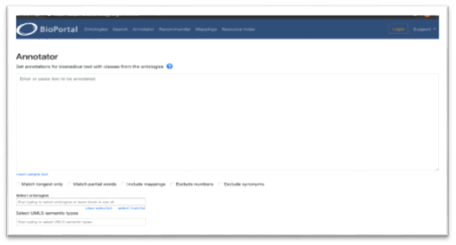
Tool 1: bioportal
Description:
Bioportal is a bio ontology website which assists in annotating words by providing links for various different websites, in which the user can obtain meanings and definitions of words.

Slide 8
Bioportal benefits + drawbacks
Benefits
Free web page annotation tool
Advance search options available based on databases
Customisation options according to user queries
Easy to use and handle
Get recommendations for the input query we provided
Drawbacks
We can search only ontology & Biomedical bases keywords
Limited to Biomedical uses not compatible all fields

Slide 9
Bioportal costs + compatibility
Costs
Bioportal annotator is an open source tool, free for anyone to use at no cost.
There is a login option where user is able to create their account and download the latest versions of ontologies for their work.
Compatibility
The most important feature that aligns with aim and deliverables is the annotator.
As our project is based around the features and uses of text annotation. We will integrate two API’s from the existing ontology libraries and develop an annotator.

Slide 10
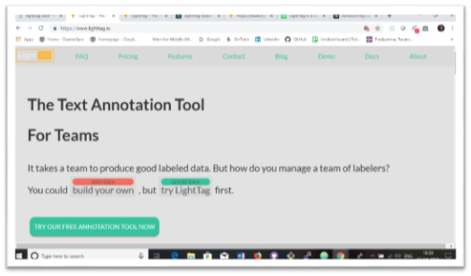
Tool 2: lightag
Description
Lightag is a useful text annotation website/tool. It is predominantly used as text annotation platform for data scientists creating AI training data. LightTag aims to solve one of the main bottlenecks of the deep learning-based AI development.

Slide 11
Lightag benefits + Drawbacks
Benefits
Can annotate in any language
Measures inter annotator agreement to understand the quality of annotation
Continuously boot straps the projects and provides suggestions
Can add new meaning from our own library and upload it to LightTag with Rest API
Drawbacks
Provides hourly rate for engineers to build own labelling tools
Comes with only in on-premise version

Slide 12
lightag costs + compatibility
Costs
The tool is It is free of cost and only requires the user to create an account in order to use the tool. The tool can be downloaded and is especially useful for team projects.
Compatibility
Annotation capabilities which are similar to our aims. Some of the annotation or user features could be similarly designed in our project, although Lightag is aimed at AI, which our project does not have much focus on.

Slide 13
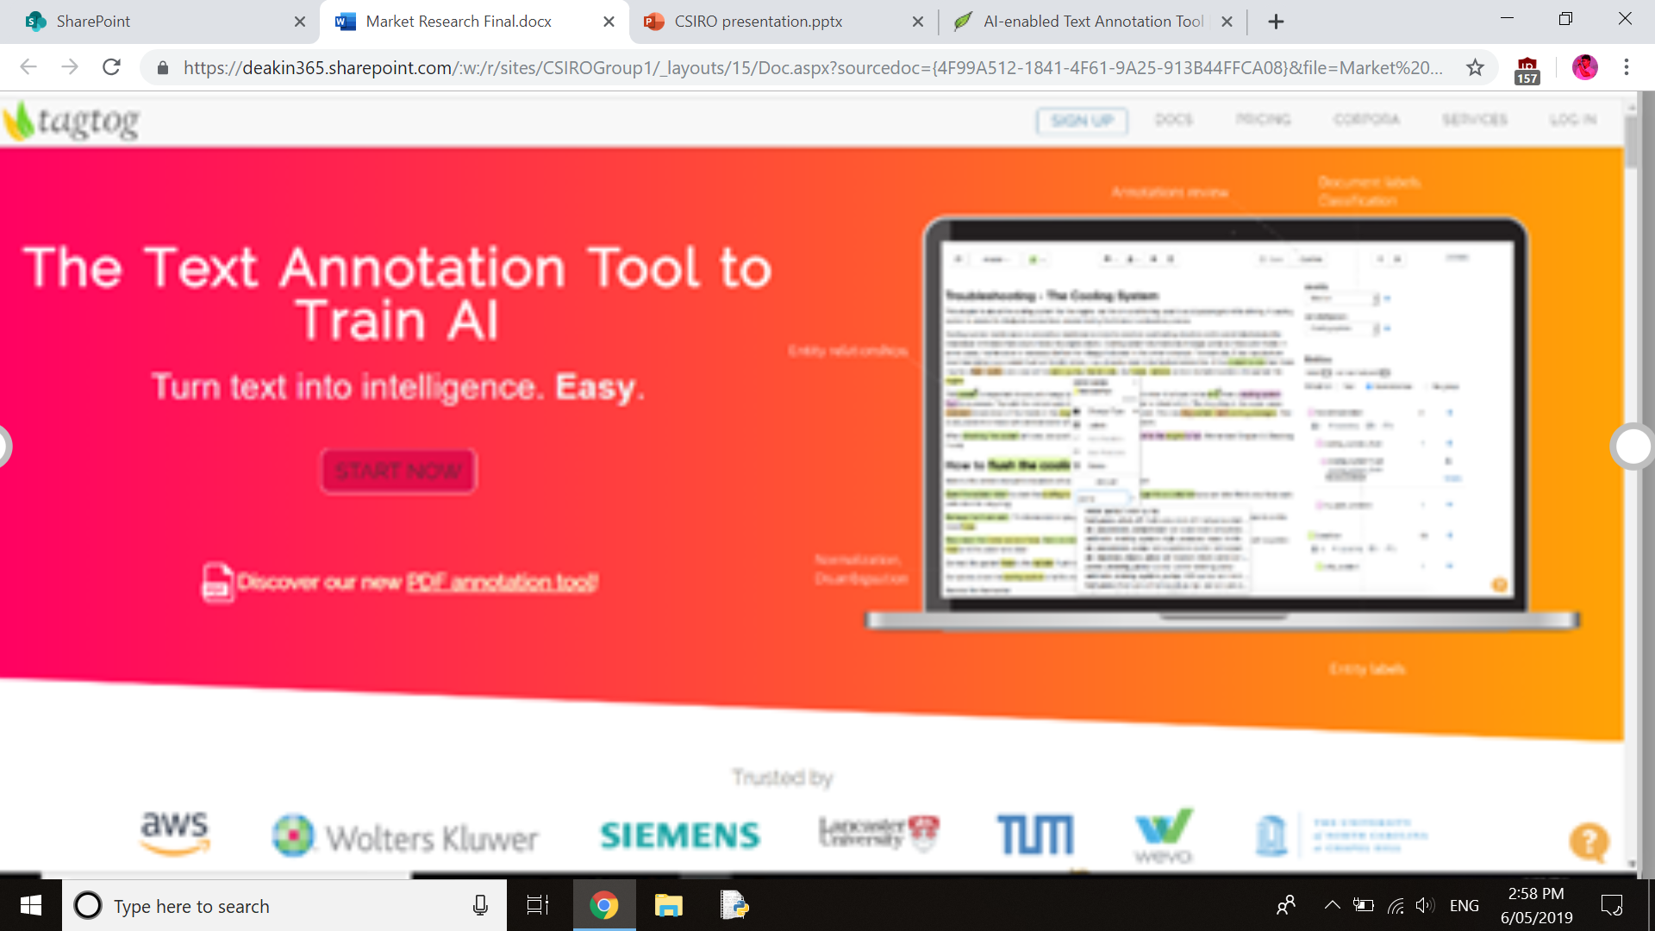
Tool 3: TAGTOG
Description:
Users can install TagTog for their computer or they can use website for start their works. Mainly TagTog is use for group works. Because, admin or owner has an option for invite others who can help to develop the project. This is most critical point for any kind of group workers.
Annotate of this tool is use as manually or automatically. It will eventually save the costs and time. Collaboration is also a massive space for succeed the project. Not only that, below options are the major part of TagTog,
Index data or augment
Find custom insights inn text automatically
Classify text
Train your own AI

Slide 14
tagtog benefits + drawbacks
Benefits
Customization the options.
Easy to use and handle.
Can select different members.
Has a good speed.
Drawbacks
Only leader can add or delete comment
Need to log in every time.

Slide 15
tagtog costs + compatibility
Costs
Tagtog cost accoring to the membership
Compatibility
The tool of is freely available for anyone to use and can be downloaded for anyone.

Slide 16
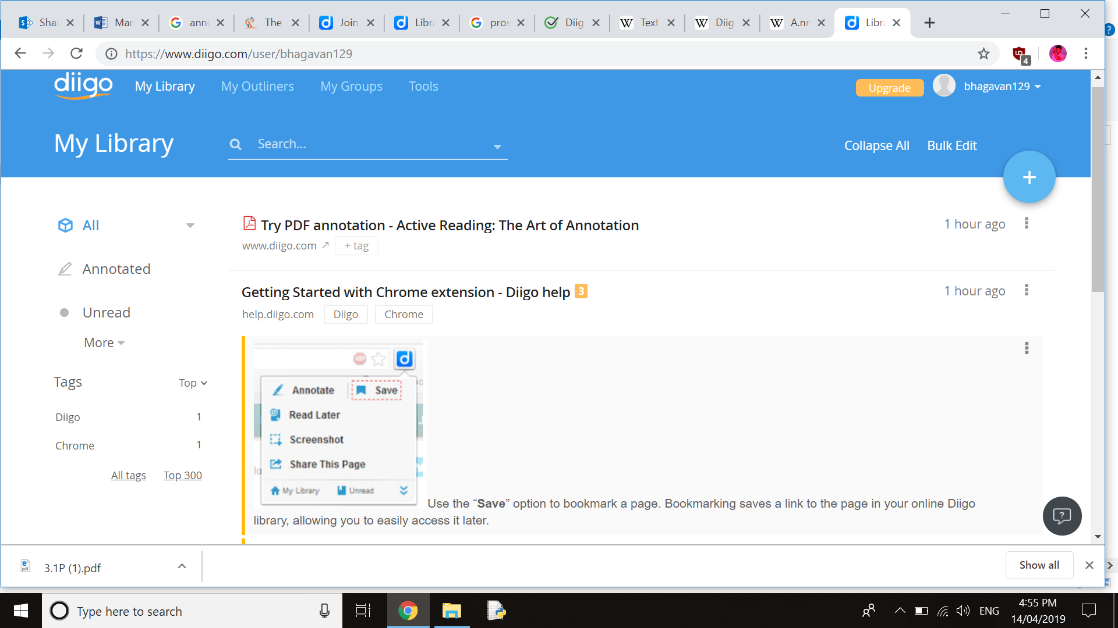
Tool 4: Diigo
Description
* It is one of the most commonly used tool for web annotation which let you bookmark and tag web pages. In addition to it we would also be able to highlight a part of a webpage if you wish to emphasize something and attach sticky notes to it.

Slide 17
Diigo benefits + drawbacks
Benefits
Customization options in this tool and social feature help students learn key web skills like curating and sharing online content.
Easy to install extension and start knowledge from around the internet it is a great capturing tool.
The features it offers to collect articles and text snaps from the web and pdf are quite nice and can be really useful.
Drawbacks
the user need to be logged into Diigo and stay within one browser tab to use the system. And there isn’t much guidance on selecting sources.
The premium versions are a bit pricy.
As a free user you are given limited usage of the software including a limit on how many words you can highlight and bookmarks. If it is a tool that is used very often, it is worth spending.

Slide 18
Diigo costs + compatibility
Costs
Diigo membership varies in three ranges standard, professional, business. These are applicable for the members in Diigo. The price varies according to the ranges.
Compatibility
The tool is freely available for any one to use and can be downloaded.

Slide 19
Feasibility analysis
Based on initial understanding of the basic requirements of the tool that is to be developed and the research undertaken into other relevant tools, it appears that the development of analytical text tool is feasible.
However, There are a range of similar tools that meet many of the requirements of the tool, which could be used instead of committing to the cost of developing a new similar tool.
There are benefits of developing a new tool from scratch in order to ensure that all the requirements are met and all the features align with the tools purpose.
A cost/benefit analysis would be a good step in determining the certainty of a financial payoff, however simply based of the information available at this point in time, a new tool could be foundationally modelled off the most similar existing tool and adjusted and developed to Superseed the original and meet all requirements.
This conclusion however is based solely off the information provided and independent research and therefore cannot take into consideration the availability and longevity of finances.

Slide 20
Recommendations
Our primary recommendation is to undertake a cost benefit analysis of developing a new tool, rather than alter an existing an open source tool
Based on research it would be more beneficial to alter an existing tool than spend time, money and resources developing a tool from scratch.
It would depend however, on the volume of changes required to align with the features

Slide 21
References
Bioportal.bioontology.org. (2019). Welcome to the NCBO BioPortal | NCBO BioPortal. [online] Available at: https://bioportal.bioontology.org/ [Accessed 5 May 2019].
Medium. (2019). Announcing LightTag — The easy way to Annotate text. [online] Available at: https://medium.com/@TalPerry/announcing-lighttag-the-easy-way-to-annotate-text-afb7493a49b8 [Accessed 6 May 2019].
"AI-enabled Text Annotation Tool | PDF, Markdown, CSV, html, tweets, & many more types of Documents", Tagtog.net, 2019. [Online]. Available: https://www.tagtog.net/. [Accessed: 08- Apr- 2019].
Social Annotations, Highlighting and Social Bookmarking, retrieved 4 July 2006, <https://www.diigo.com/>

